Slide 1

Basic Algebra
Functions, polynomials, coordinate systems, complex numbers
Yordan Darakchiev
Technical Trainer
iordan93@gmail.com

Slide 2
sli.do #MathForDevs

Slide 3
Table of Contents
Polynomials
Sets
Functions
Coordinates
Complex numbers
Abstraction

Slide 4
Polynomials
Definition, storing, basic operations

Slide 5
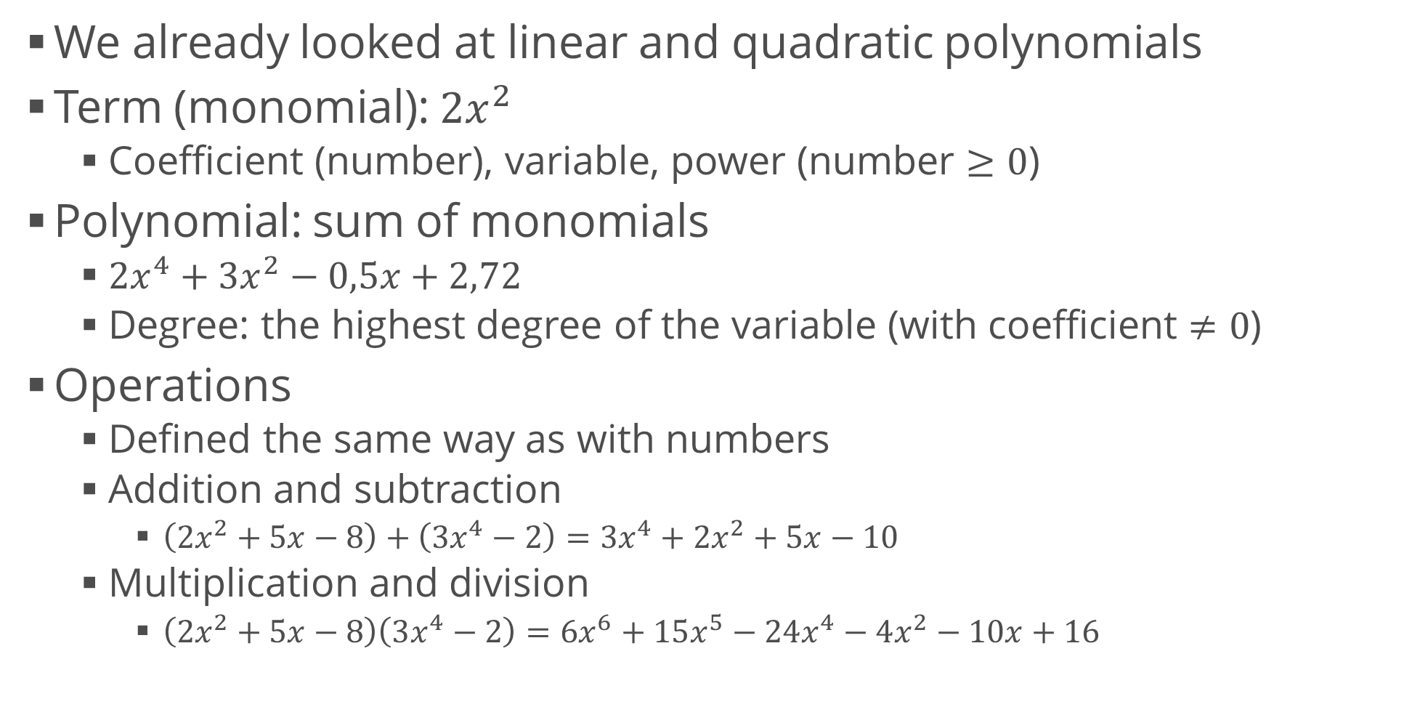
Polynomials
We already looked at linear and quadratic polynomials
Term (monomial): $2x^{2}$
Coefficient (number), variable, power (number $≥0$)
Polynomial: sum of monomials
$2x^{4}+3x^{2}−0,5x+2,72$
Degree: the highest degree of the variable (with coefficient $≠0$)
Operations
Defined the same way as with numbers
Addition and subtraction
$\left(2x^{2}+5x−8\right)+\left(3x^{4}−2\right)=3x^{4}+2x^{2}+5x−10$
Multiplication and division
$\left(2x^{2}+5x−8\right)\left(3x^{4}−2\right)=6x^{6}+15x^{5}−24x^{4}−4x^{2}−10x+16$

Slide 6
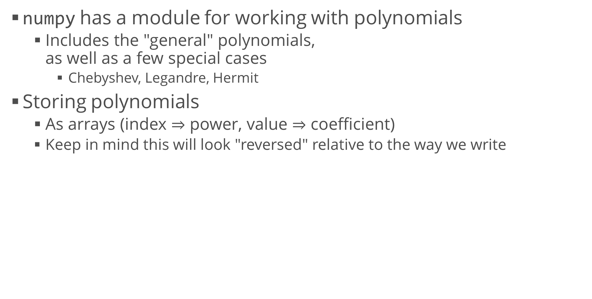
Polynomials in Python
numpy has a module for working with polynomials
Includes the "general" polynomials, as well as a few special cases
Chebyshev, Legandre, Hermit
Storing polynomials
As arrays (index $⇒$ power, value $⇒$ coefficient)
Keep in mind this will look "reversed" relative to the way we write
import numpy.polynomial.polynomial as p
p.polyadd([-8, 5, 2], [-2, 0, 0, 0, 3])
p.polymul([-8, 5, 2], [-2, 0, 0, 0, 3])
# array([-10., 5., 2., 0., 3.])
# array([ 16., -10., -4., 0., -24., 15., 6.])

Slide 7
Polynomials in Python (2)
Pretty printing
Use sympy to print the polynomial
If it's a list, use it directly
If it's a Polynomial object, call the coef property
Reverse the order of coefficients (sympy expects them from highest to lowest)
import sympy
from sympy.abc import x
polynomial = p.Polynomial([-2, 0, 0, 0, 3])
sympy.init_printing()
print(sympy.Poly(reversed(polynomial.coef), x).as_expr())
# Output: 3.0*x**4 - 2.0

Slide 8
Sets
Set notation and basic operations

Slide 9

Set
An unordered collection of things
Usually numbers
No repetitions
Set notation:
"The set of numbers x, which are a subset of the real numbers, which are greater than or equal to zero"
Left: example element
Right: conditions to satisfy
Python set comprehensions
Very similar to what we already wrote
Also very similar to list comprehensions (but with curly braces)
positive_x = {x for x in range(-5, 5) if x >= 0}
# {0, 1, 2, 3, 4}

Slide 10





Set Operations
Cardinality: number of elements
Checking whether an element is in the set:
Checking whether a set is subset of another set:
Union , intersection , difference
set1 = { 1, 2, 3, 4 }
set2 = {3, 4, 5, 10, 3, 5, 10, 3, 3}
print(len(set2)) # 4
print(1 in set1) # True
print(10 not in set1) # True
print({1, 2}.issubset(set1)) # True
print(set1.union(set2)) # {1, 2, 3, 4, 5, 10}
print(set1.difference(set2)) # {1, 2}
print(set2.difference(set1)) # {10, 5}
print(set1.symmetric_difference(set2)) # {1, 2, 5, 10}

Slide 11
Functions
Mappings from one thing to another

Slide 12




Function
A relation between
A set of inputs (domain)
… and a set of outputs (codomain)
One input produces exactly one output
The inputs don't need to be numbers
Functions don't know how to compute the output, they're just mappings
In programming, we write procedures
Math notation:
Commonly abbreviated as
Some more definitions
Injective (one-to-one): unique inputs => unique outputs
Surjective (onto): every element in the codomain is mapped
Bijective (one-to-one correspondence): injective and surjective
Here is a graphical view

Slide 13
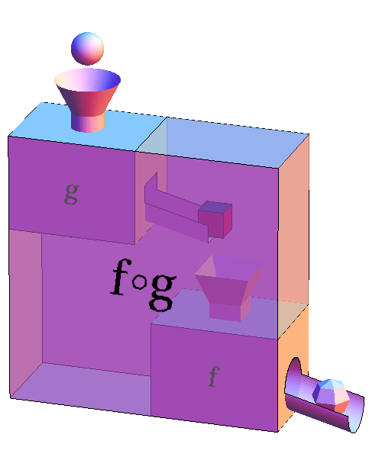


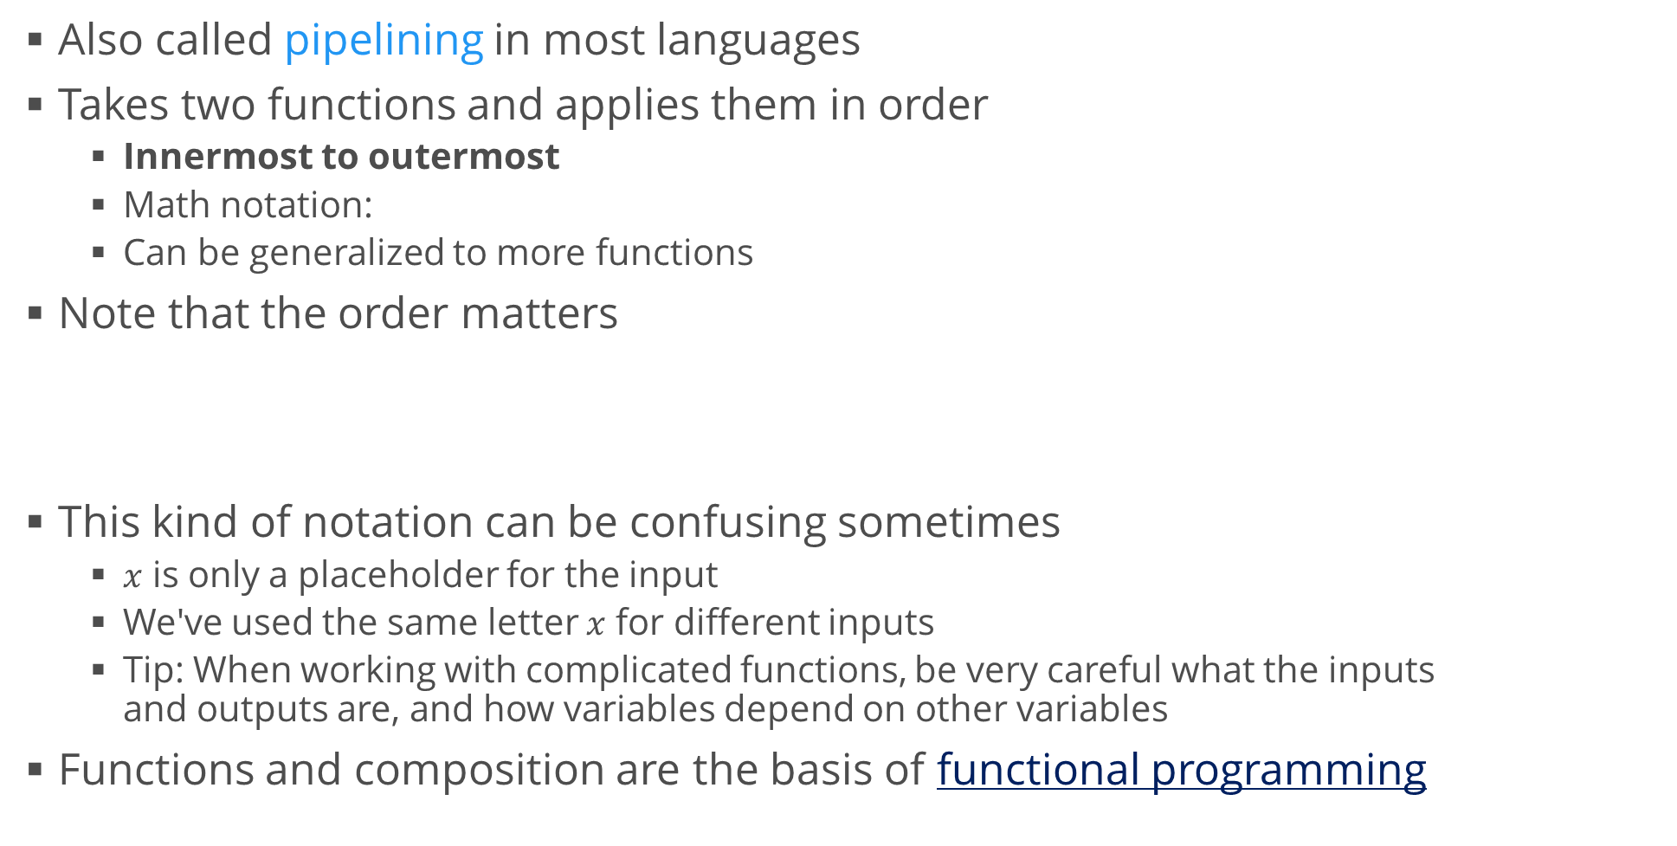
Function Composition
Also called pipelining in most languages
Takes two functions and applies them in order
Innermost to outermost
Math notation:
Can be generalized to more functions
Note that the order matters
This kind of notation can be confusing sometimes
$x$ is only a placeholder for the input
We've used the same letter $x$ for different inputs
Tip: When working with complicated functions, be very careful what the inputs and outputs are, and how variables depend on other variables
Functions and composition are the basis of functional programming

Slide 14
Function Graphs
One very intuitive way to get to know functions is to plot them
We already did that in the last exercise
Generate values in the domain (independent variable)
For each value compute the output (dependent variable)
Create a graph; plot all computed points and connect them with tiny straight lines
lambda in Python is a short syntax for a function
We can define it outside as well (it's just shorter and simpler to use it inline)
import numpy as np
import matplotlib.pyplot as plt
def plot_function(f, x_min = -10, x_max = 10, n_values = 2000):
x = np.linspace(x_min, x_max, n_values)
y = f(x)
plt.plot(x, y)
plt.show()
plot_function(lambda x: np.sin(x))

Slide 15
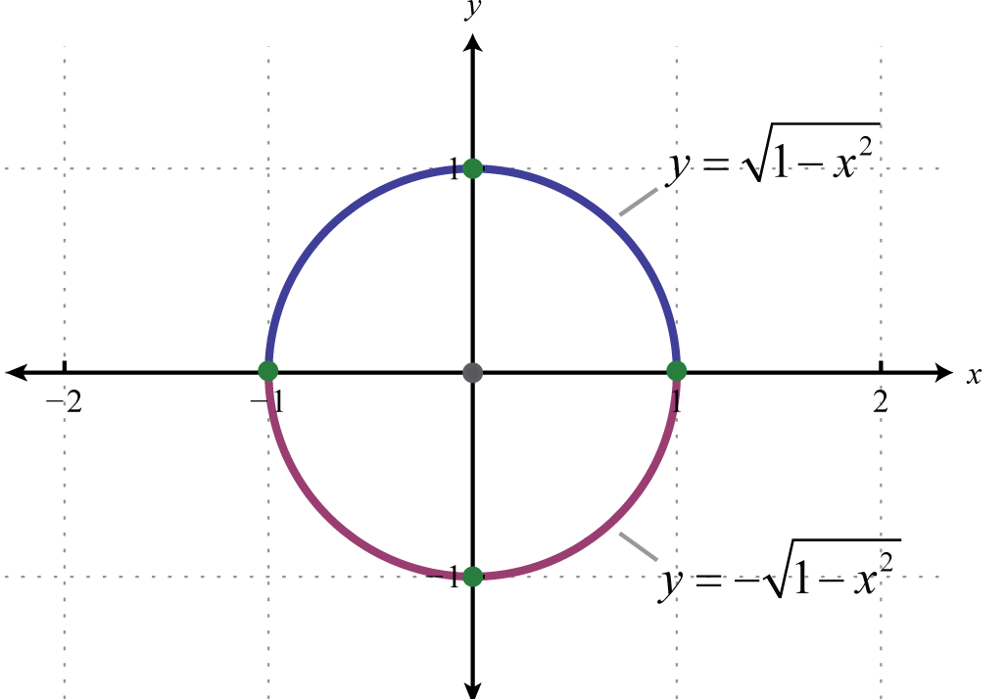


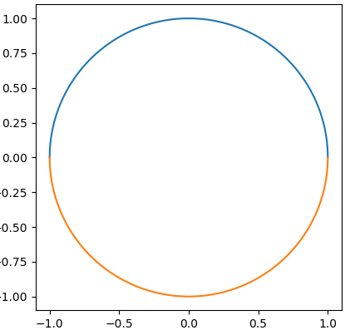
Graphing a Circle
Let's try to graph the unit circle
Equation:
This cannot be represented as one function
We have multiple values of , e. g.
We can try two functions (see graph)
But we want to represent the circle as one object
def plot_function(f, x_min = -10, x_max = 10, n_values = 2000):
plt.gca().set_aspect("equal")
x = np.linspace(x_min, x_max, n_values)
y = f(x)
plt.plot(x, y)
plot_function(lambda x: np.sqrt(1 - x**2), -1, 1)
plot_function(lambda x: -np.sqrt(1 - x**2), -1, 1)
plt.show()

Slide 16
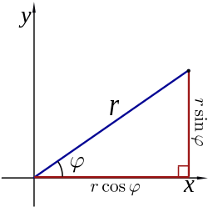





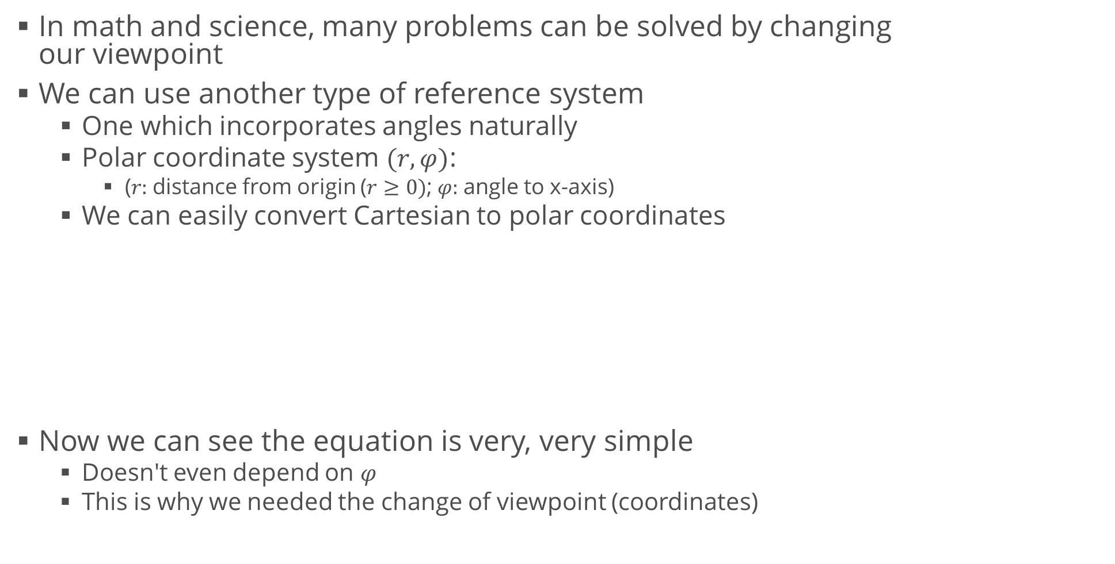
Graphing a Circle (2)
In math and science, many problems can be solved by changing our viewpoint
We can use another type of reference system
One which incorporates angles naturally
Polar coordinate system $(r, φ)$:
($r:$distance from origin ($r≥0)$; $φ:$angle to x-axis)
We can easily convert Cartesian to polar coordinates
Now we can see the equation is very, very simple
Doesn't even depend on $φ$
This is why we needed the change of viewpoint (coordinates)

Slide 17
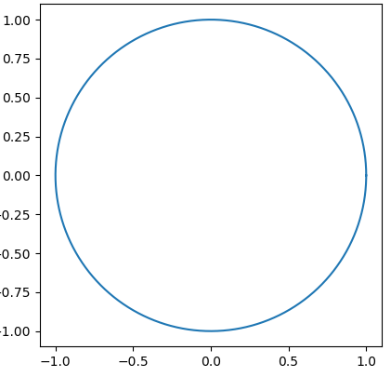

Graphing a Circle (3)
Graphing a function in polar coordinates
This applies to any function, circles in particular
Generate initial values of $r$ and $φ$
Convert them to rectangular coordinates
Plot the rectangular coordinates
For most other applications we can do this directly
import numpy as np
import matplotlib.pyplot as plt
r = 1 # Radius
phi = np.linspace(0, 2 * np.pi, 1000) # Angle (full circle)
x = r * np.cos(phi)
y = r * np.sin(phi)
plt.plot(x, y)
plt.gca().set_aspect("equal")
plt.show()
plt.polar(phi, r)

Slide 18
Complex Numbers
Not as complex as they seem

Slide 19






Number Fields
Field
A collection of values with operations "plus" and "times"
Algebra is so abstract we can redefine these operations (stay tuned)
History of number fields
Natural (counting) numbers
Integers
Subtraction
Rational numbers : ratio of two integers
Division
This is the smallest field
Real numbers
Most roots (e.g. )
Complex numbers
All roots (including square roots of negative numbers)
"Imaginary unit": is the positive solution of

Slide 20




Complex Numbers
Pairs of real numbers:
Commonly written as
Real part: , imaginary part:
In Python, we use j instead of i
Note that we write 1j to prevent confusion with the variable j
For the same reason, we don't write 2 * j if j is the imaginary unit
We can get the real and imaginary parts
Adding and multiplying complex numbers
3j
1j
3 + 2j
z = 3 + 2j
print(z.real) # 3
print(z.imag) # 2
print((3 + 2j) + (8 - 3j)) # (11-1j)
print((3 + 2j) * (8 - 3j)) # (30+7j)

Slide 21
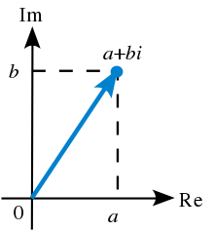
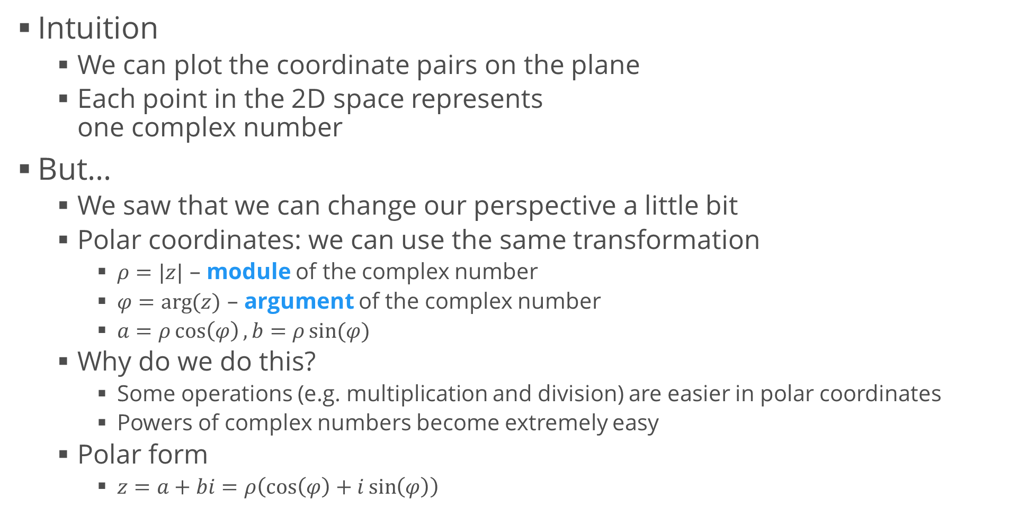
Geometric Interpretation
Intuition
We can plot the coordinate pairs on the plane
Each point in the 2D space represents one complex number
But…
We saw that we can change our perspective a little bit
Polar coordinates: we can use the same transformation
$ρ=|z|$ – module of the complex number
$φ=\arg{(z)}$ – argument of the complex number
$a=ρ\cos\left(φ\right), b=ρ\sin{(φ)}$
Why do we do this?
Some operations (e.g. multiplication and division) are easier in polar coordinates
Powers of complex numbers become extremely easy
Polar form
$z=a+bi=ρ\left(\cos\left(φ\right)+i\sin\left(φ\right)\right)$

Slide 22



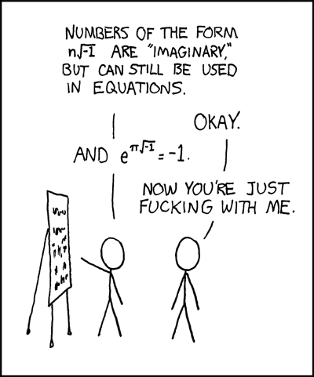
Euler's Formula
Leonhard Euler proved that
Here's a summary of the proof if you're interested
It involves series which we haven't covered yet
A very beautiful consequence:
Now we can write our complex number as
Why and how does multiplication work?
Multiplication by a real number
Scales the original vector
Multiplication by an imaginary number
Rotates the original vector
You can see a thorough explanation here
Main point: Multiplication of complex numbers is the same as scaling and rotating 2D vectors
Algebra is abstract and we love it :)

Slide 23
Fundamental Theorem of Algebra
Roots, roots, and more roots

Slide 24

Fundamental Theorem of Algebra
"Every non-zero, single-variable, degree-$n$ polynomial with complex coefficients has, counted with multiplicity, exactly $n$ complex roots"
More simply said, every algebraic equation has as many roots as its power
Back to quadratic equations
How do we get all roots?
Simply use the complex math Python module: cmath
import cmath
def solve_quadratic_equation(a, b, c):
discriminant = cmath.sqrt(b * b - 4 * a * c)
return [
(-b + discriminant) / (2 * a),
(-b - discriminant)/(2 * a)]
print(solve_quadratic_equation(1, -3, -4)) # [(4+0j), (-1+0j)]
print(solve_quadratic_equation(1, 0, -4)) # [(2+0j), (-2+0j)]
print(solve_quadratic_equation(1, 2, 1)) # [(-1+0j), (-1+0j)]
print(solve_quadratic_equation(1, 4, 5)) # [(-2+1j), (-2-1j)]

Slide 25
Some More Notes
Taking abstraction to the max

Slide 26
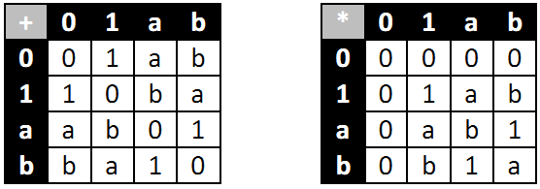
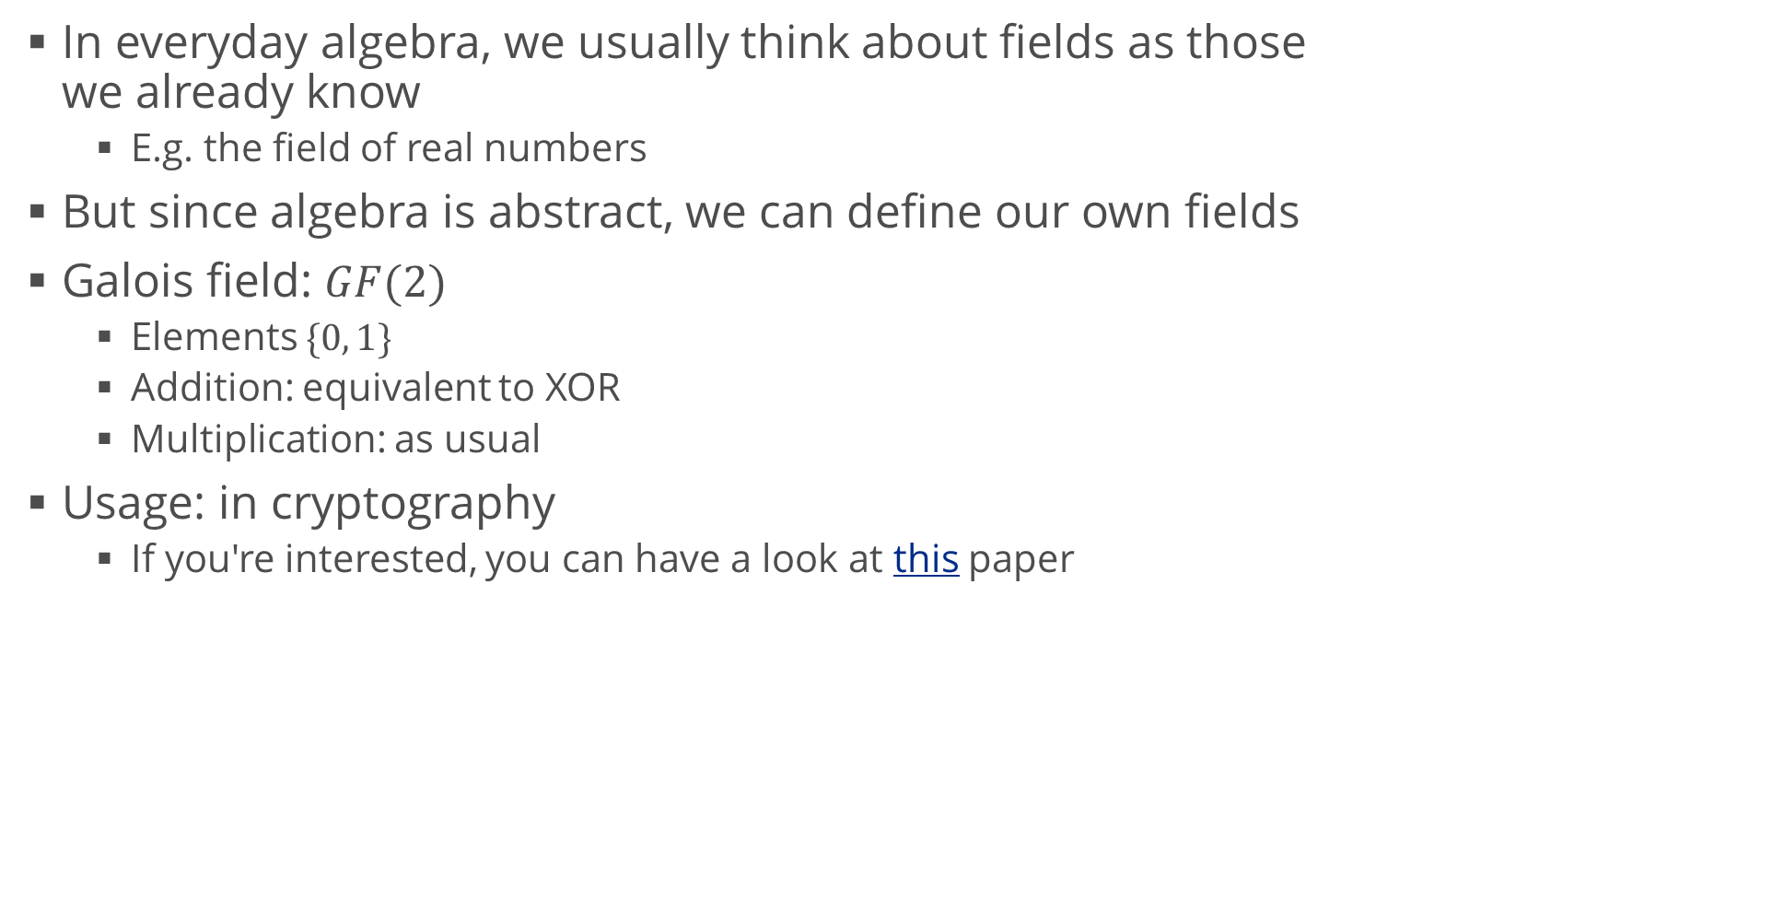
Galois Field
In everyday algebra, we usually think about fields as those we already know
E.g. the field of real numbers
But since algebra is abstract, we can define our own fields
Galois field: $GF(2)$
Elements $\{0, 1\}$
Addition: equivalent to XOR
Multiplication: as usual
Usage: in cryptography
If you're interested, you can have a look at this paper

Slide 27
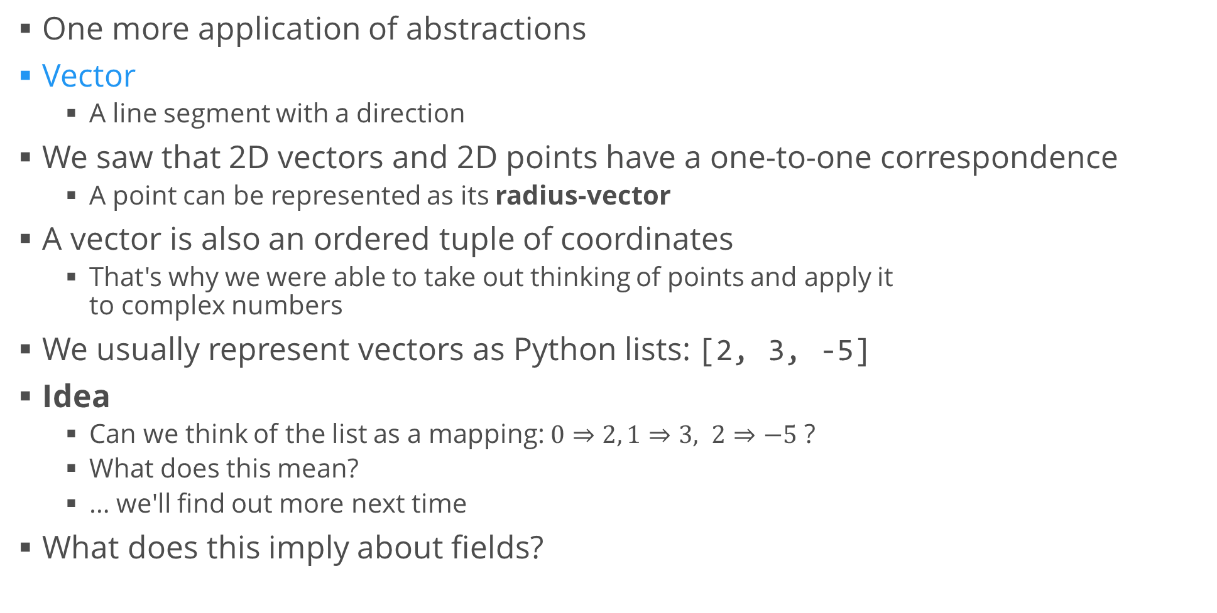
A Note about Vectors
One more application of abstractions
Vector
A line segment with a direction
We saw that 2D vectors and 2D points have a one-to-one correspondence
A point can be represented as its radius-vector
A vector is also an ordered tuple of coordinates
That's why we were able to take out thinking of points and apply it to complex numbers
We usually represent vectors as Python lists: [2, 3, -5]
Idea
Can we think of the list as a mapping: $0⇒2, 1⇒3, 2⇒−5$ ?
What does this mean?
… we'll find out more next time
What does this imply about fields?

Slide 28
Summary
Polynomials
Sets
Functions
Coordinates
Complex numbers
Abstraction

